Slide 1
Scotland and st Andrew

Slide 2
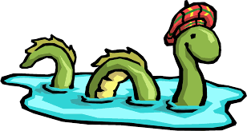
Scotland facts
Where is Scotland?
It’s in the North of Great Britain.
What are the people living in Scotland called?
Scottish. But they are also British.
How many people live in Scotland?
5 million.
What is Scotland famous for? (clue: it lives in a lake)
Loch Ness Moster
What is Loch in English?
A lake

Slide 3
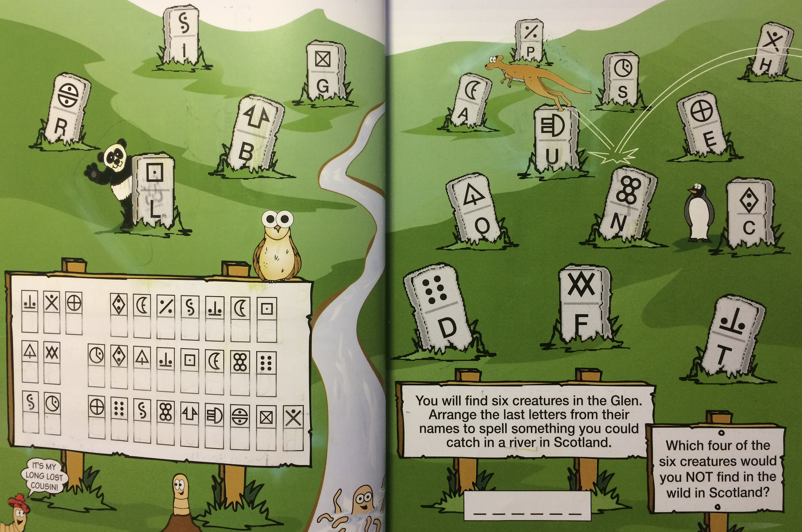

Slide 4
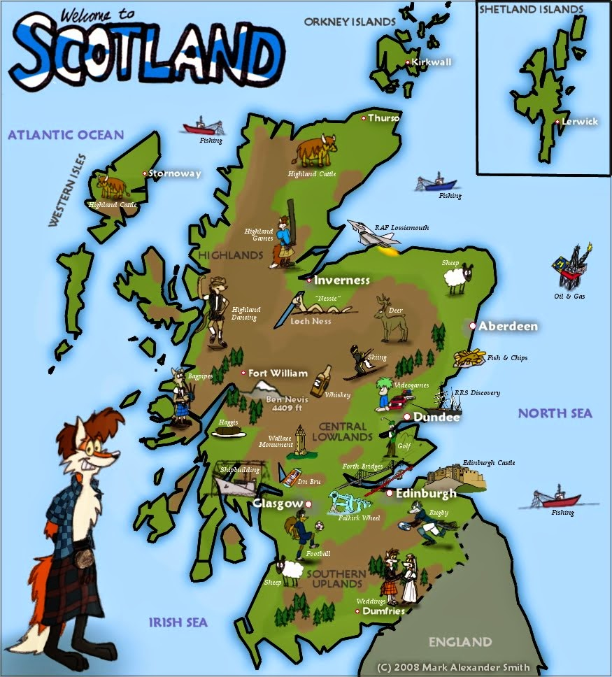
Clue: The Capital of Scotland is Edinburgh

Slide 5
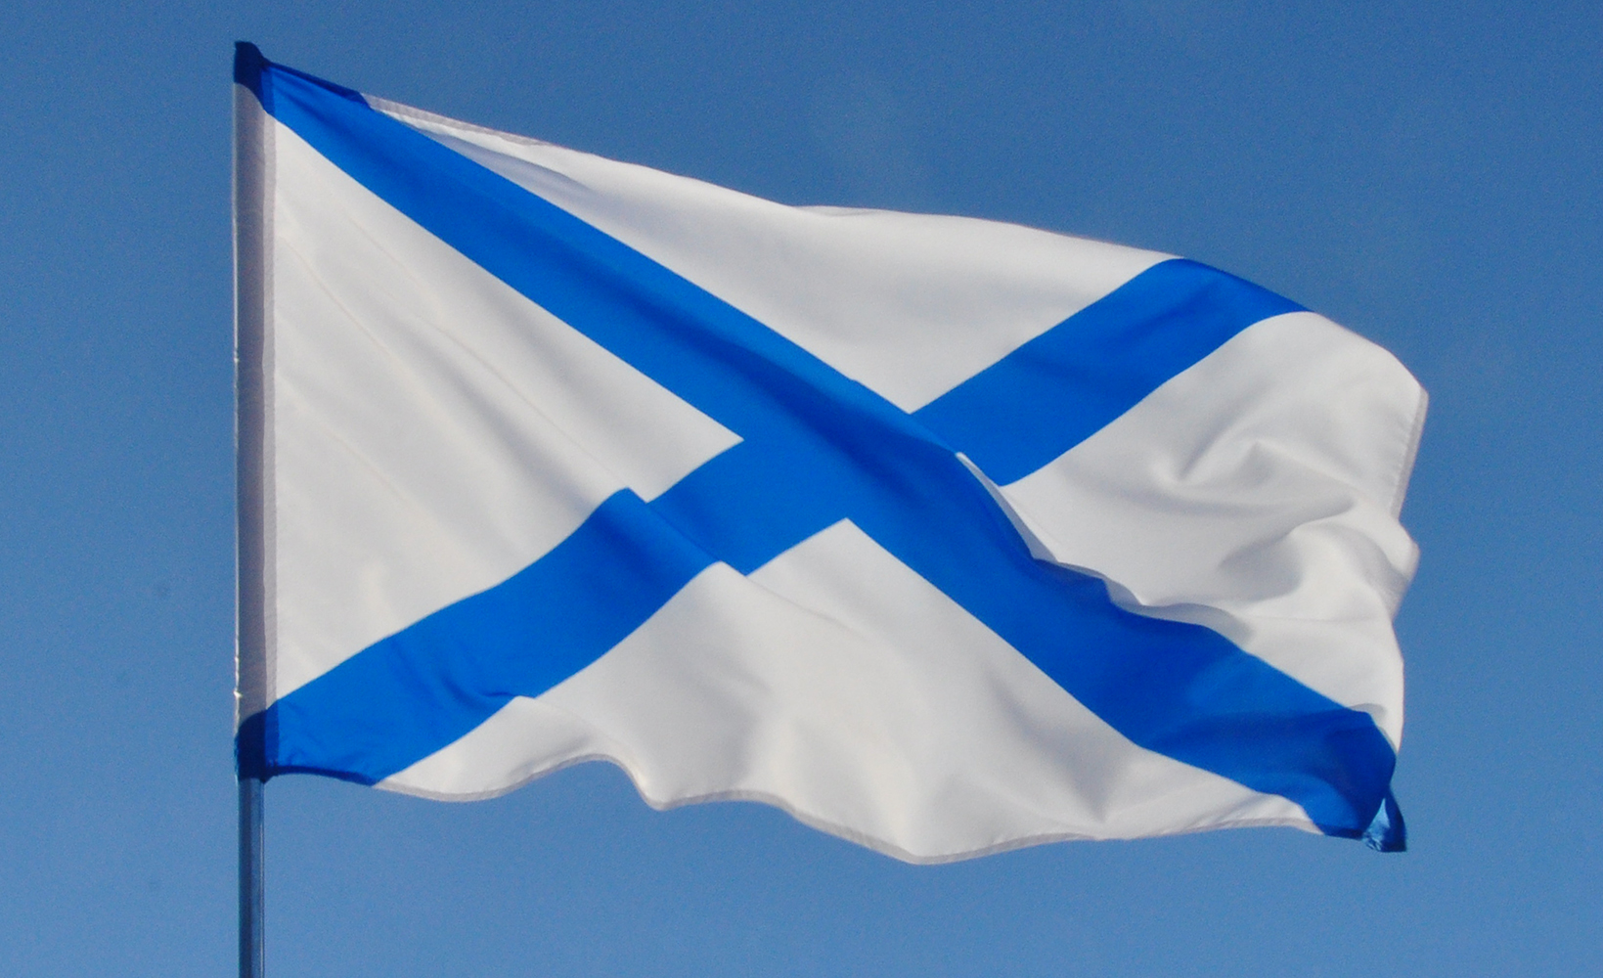
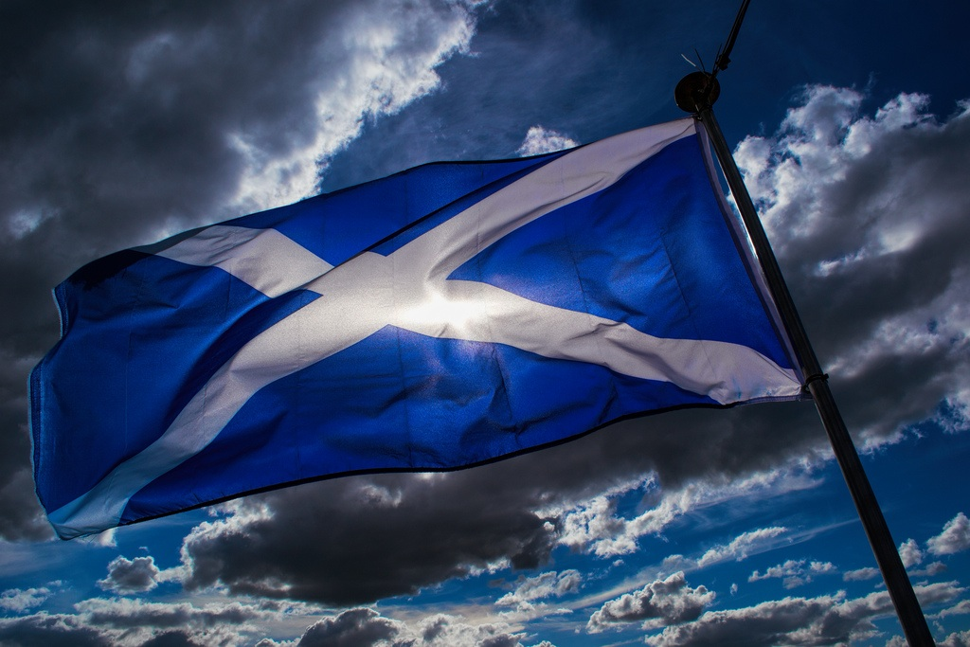

Slide 6
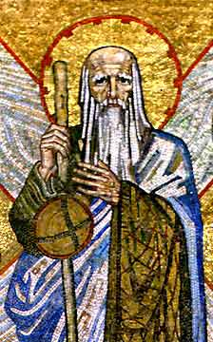
Vocabulary
Бог
God
Крест
Cross
Святой покровитель
Patron Saint
Иисус
Jesus
Апостол
Disciple
Чудо
Miracle
Проповедовать
To preach
Христианство
Christianity
Распять
To crucify
Монах
Monk
Мощи
Relics
Ангел
Angel
Андреевский крест (диагональный крест в виде буквы Х)
Saltire

Slide 8
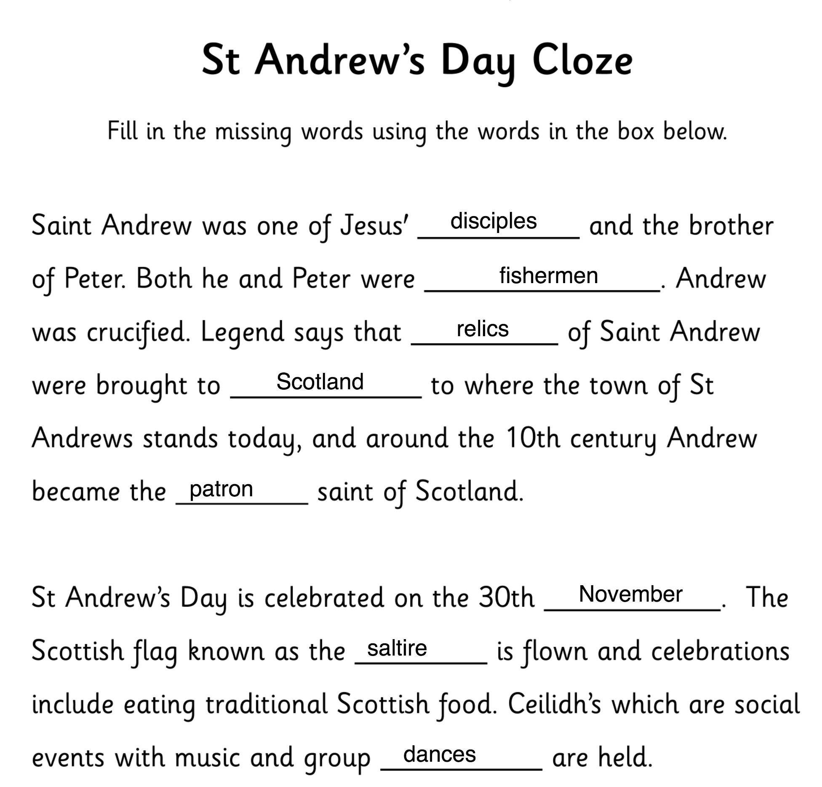

Slide 9
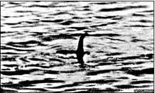

NESSIE
The Loch Ness Monster, also known as Nessie, lives in a long and deep lake in northern Scotland. Loch means lake in Scottish.
There have been many sightings of the monster. Nessie looks like a plesiosaur dinosaur.
For many centuries people have said that they have seen a monster in the lake.
The first person who saw Nessie was St. Columba, an Irish monk, in the year 545 A.D. It is said that St. Columba went to the lake to calm Nessie down and since then the monster stopped being aggressive.
In modern history, there have been many sightings of Nessie. In 1934 doctor Robert Kenneth Wilson, a doctor from London, took a picture of what it looked like a plesiosaur. In the picture you can see a long neck coming out of the water. That picture became famous. The local people started going to the lake to look for the creature. Before the famous picture was taken the locals had heard of the legend of the Loch Ness. But they didn’t think it was real.
Since the picture was taken, other people have claimed that they also have seen Nessie. There are at least 5 other pictures of the monster.
Today, The Loch Ness Monster has become a tourist attraction. Visitors from all over the world go to Loch Ness and hope to see the monster.
Nessie has never been caught. Scientists have been to the lake with all different kinds of equipment to try to find the monster. They even used a mini submarine but they weren’t lucky. Nobody knows if Nessie really exists. Some people believe Nessie exists and others don’t. Maybe one day we will know the truth.

Slide 10
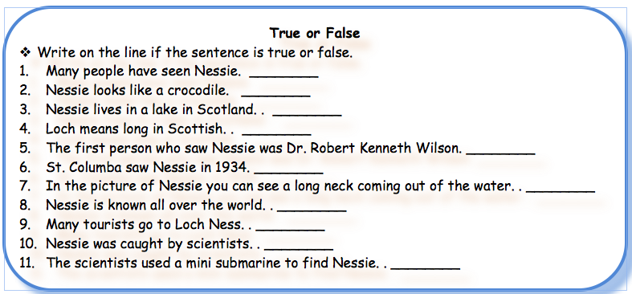

Slide 11
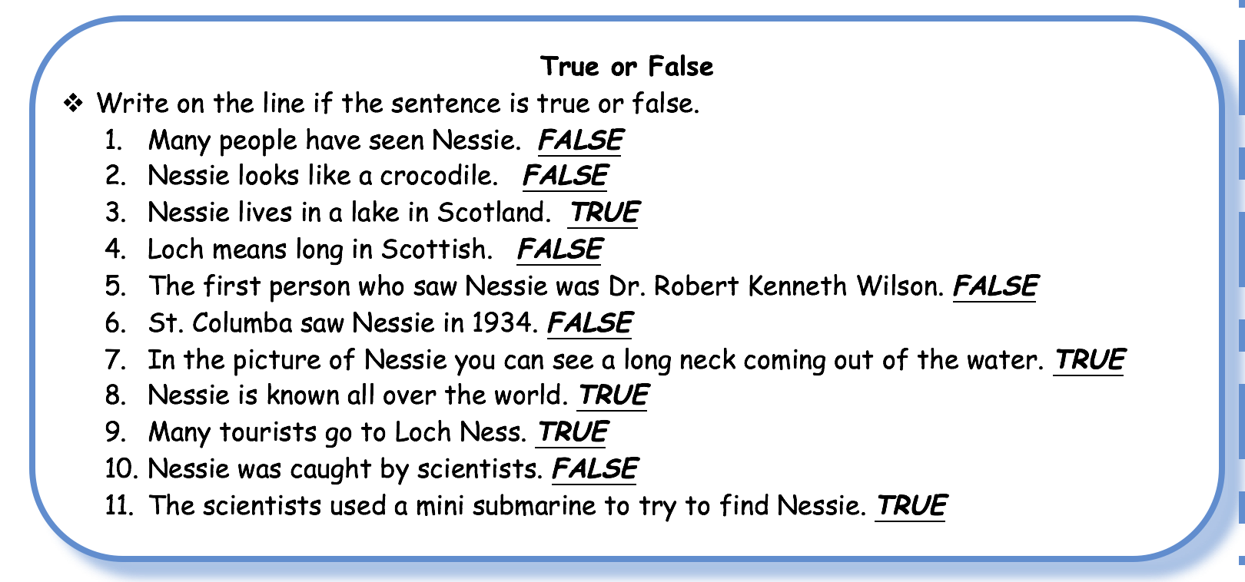

Slide 12
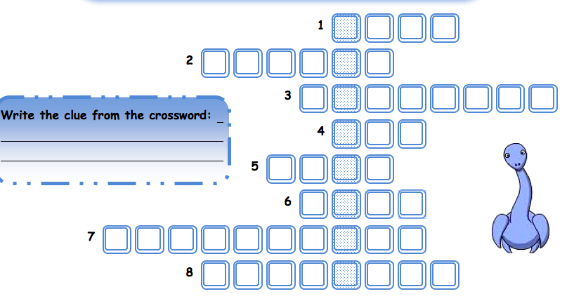
How do you say loch in English?
What profession did Robert Kenneth Wilson have?
What country does Nessie come from?
What's the past simple of have?
What was the profession of the first person who saw Nessie?
Nessie has a long…
… have tried to find Nessie.
What kind of animal is Nessie?

Slide 13
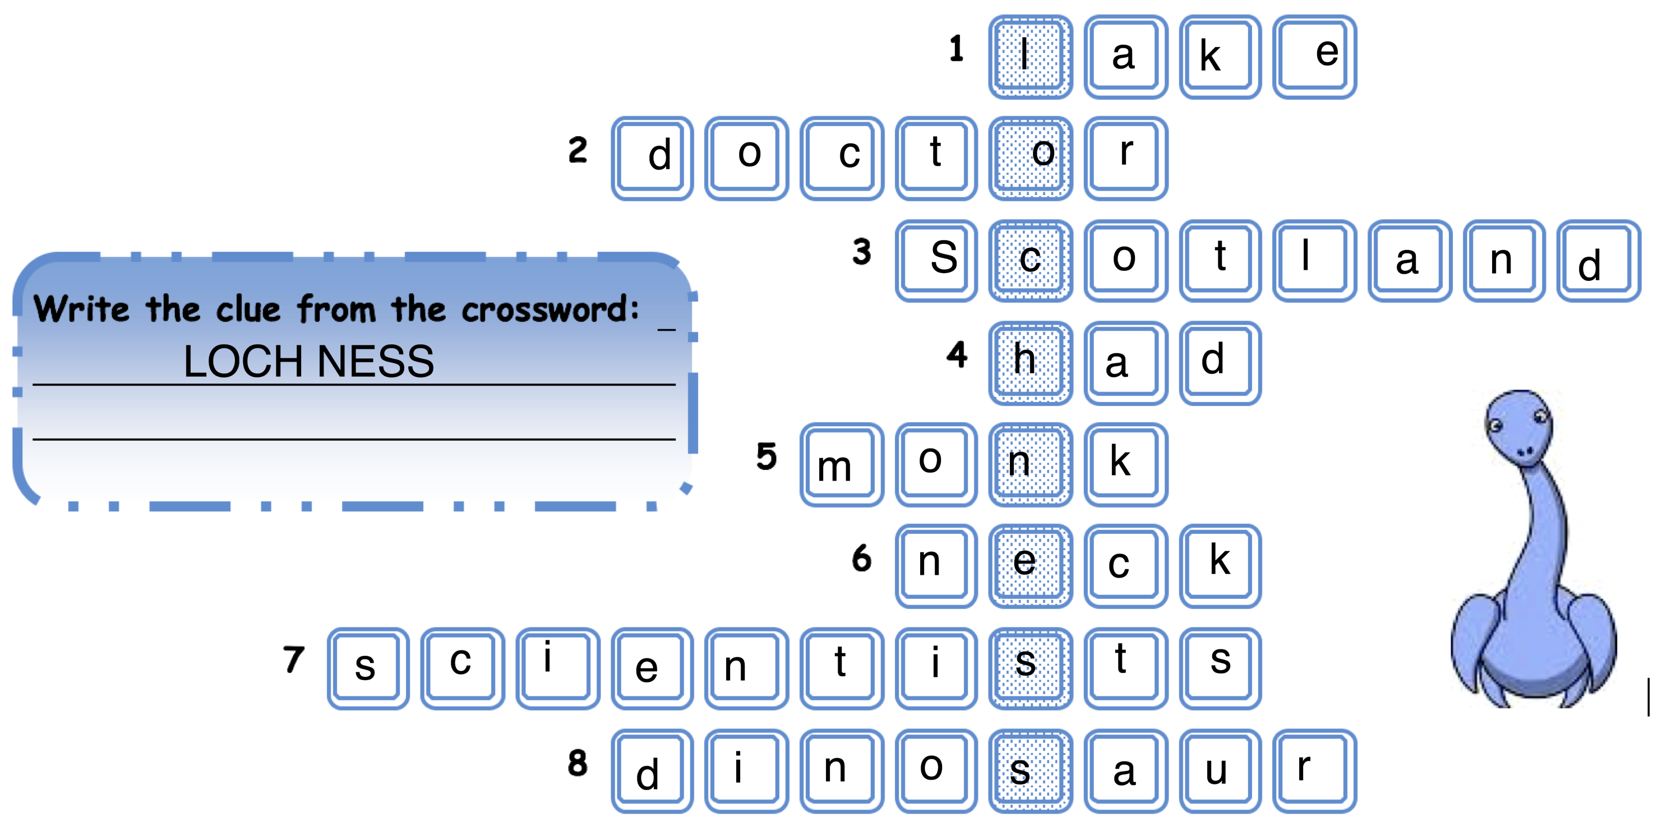

Slide 14
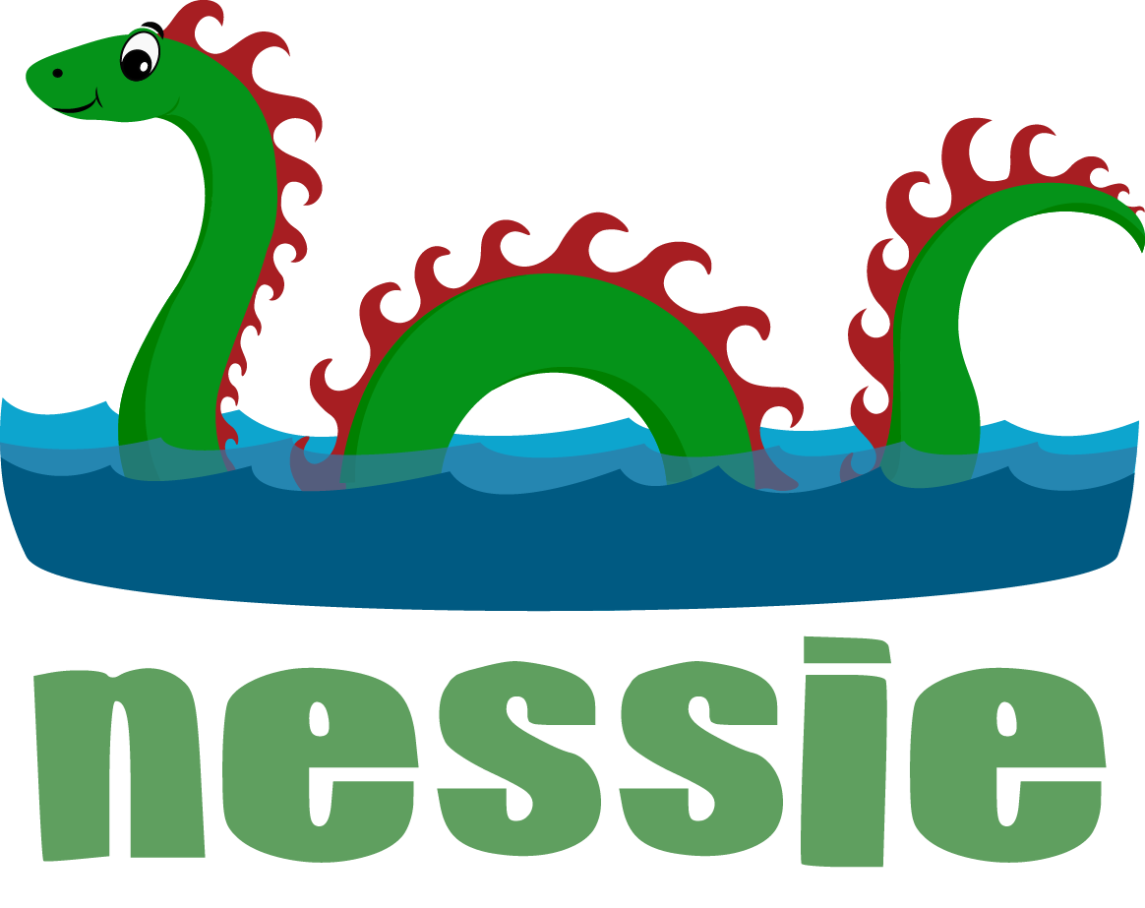
NESSIE DISCUSSION
Where does Nessie live?
What does the monster look like?
How do you think Nessie got into the Loch?
What do you think the monster eats?

